Slide 1
ISD Inventory System
Installation guide

Slide 2
Installation steps
Install MySQL Server
Install Apache Tomcat
Import database
Deploy war files

Slide 3
MySQL Installation guide
Go to https://dev.mysql.com/downloads/installer/

Slide 4
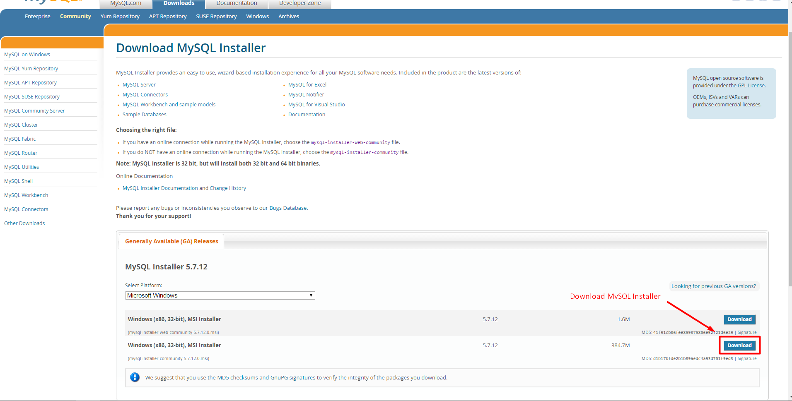
MySQL Installation guide

Slide 5
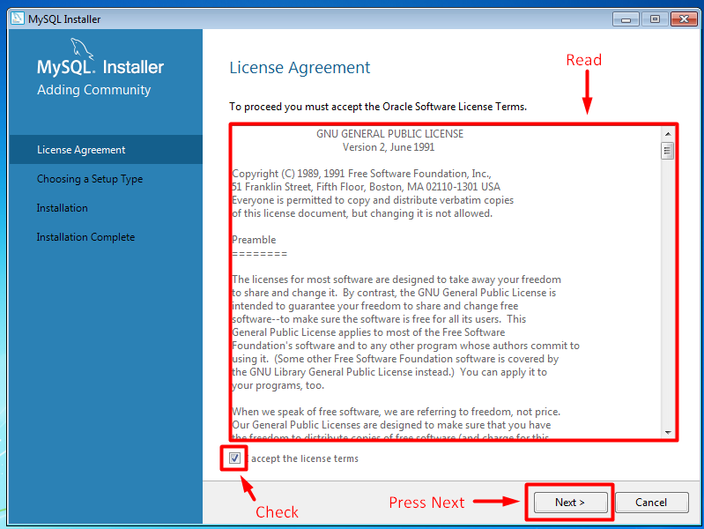
MySQL Installation guide

Slide 6
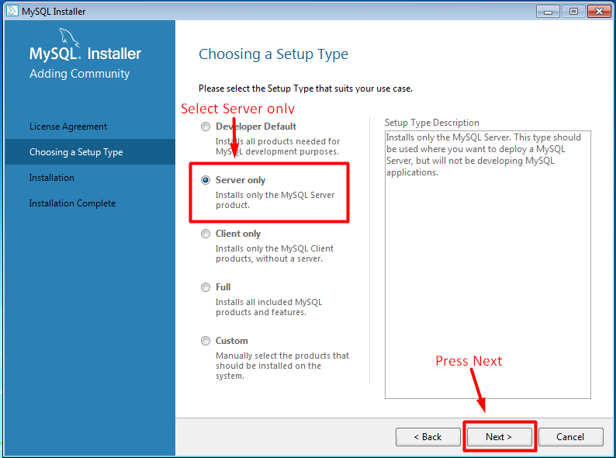
MySQL Installation guide

Slide 7
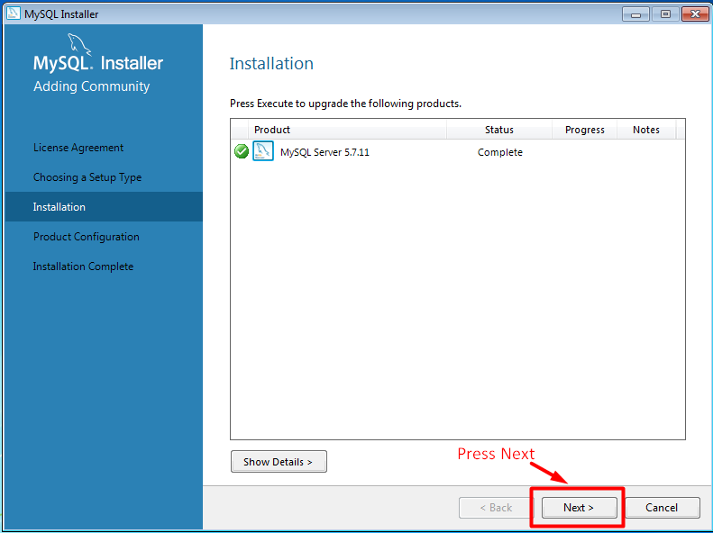
MySQL Installation guide

Slide 8
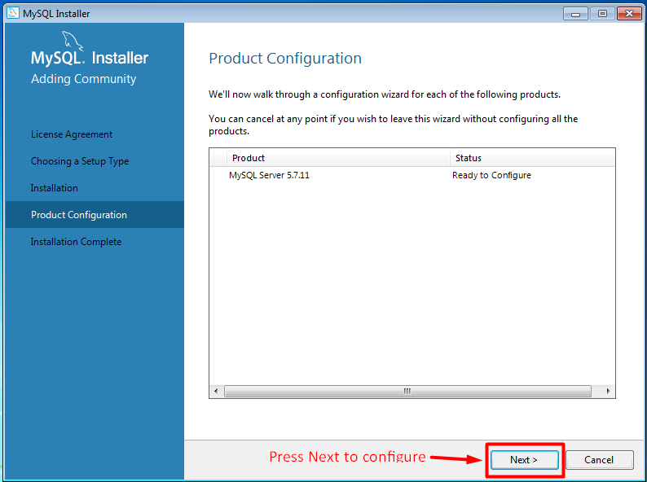
MySQL Installation guide

Slide 9
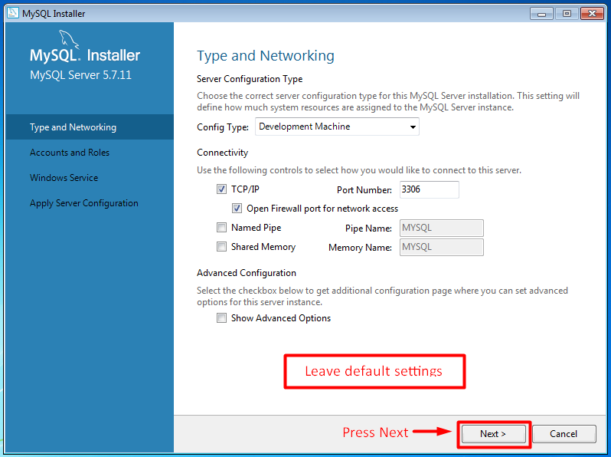
MySQL Installation guide

Slide 10
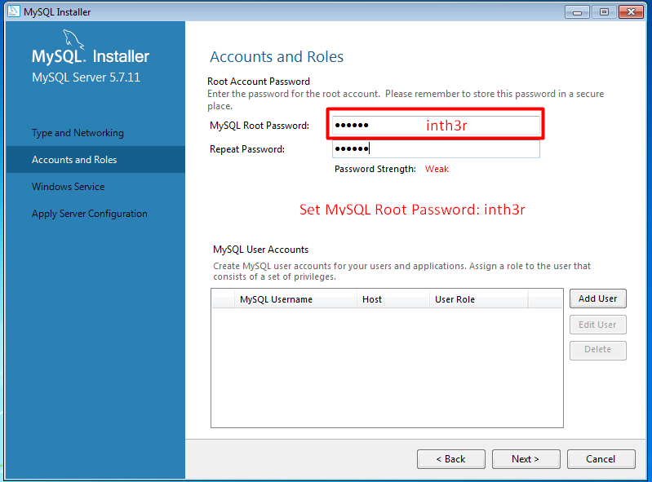
MySQL Installation guide

Slide 11
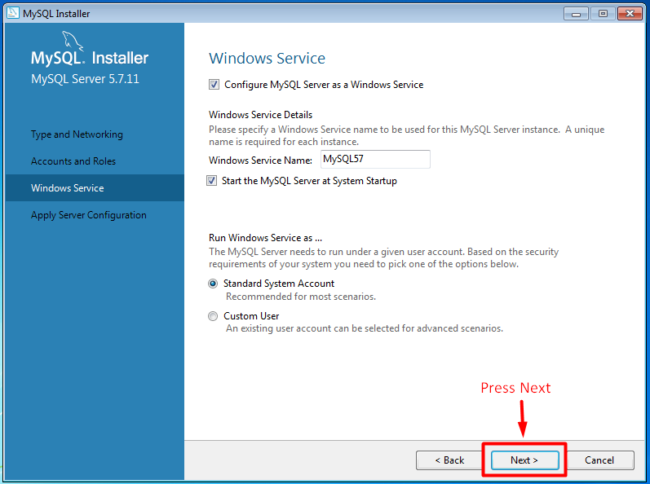
MySQL Installation guide

Slide 12
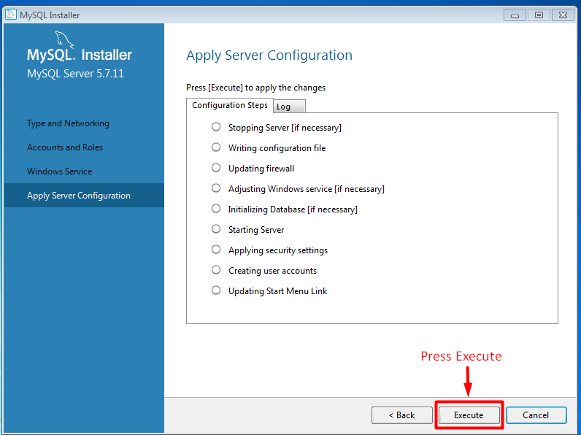
MySQL Installation guide

Slide 13
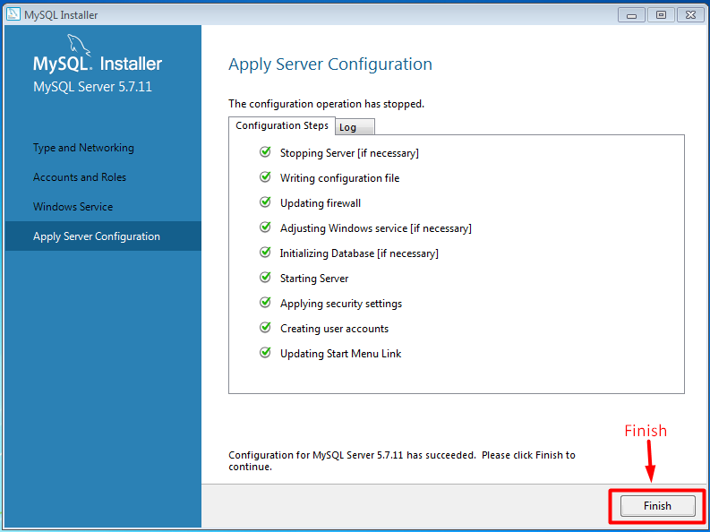
MySQL Installation guide

Slide 14
Tomcat Installation guide
Go to https://tomcat.apache.org/download-80.cgi

Slide 15
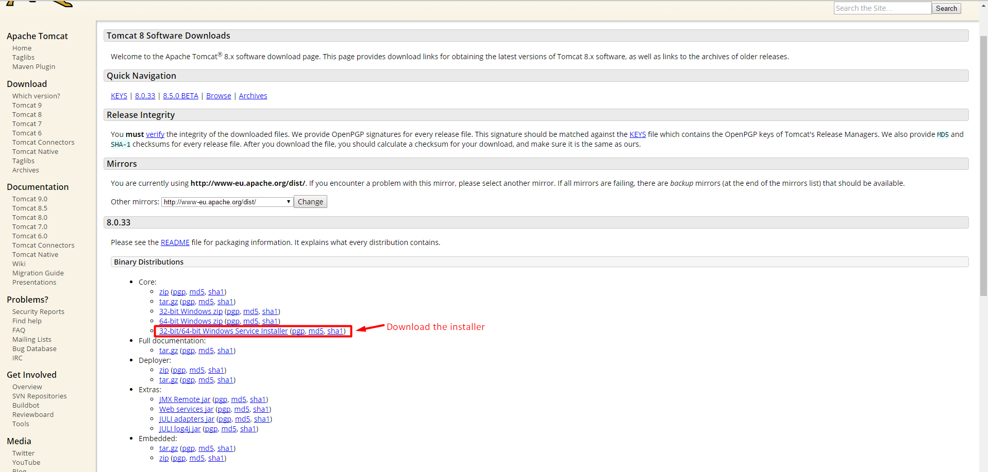
Tomcat Installation guide

Slide 16
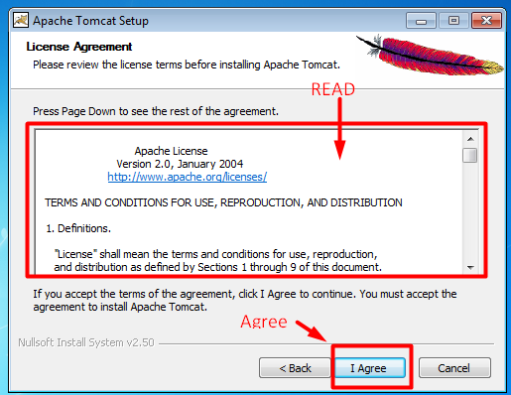
Tomcat Installation guide

Slide 17
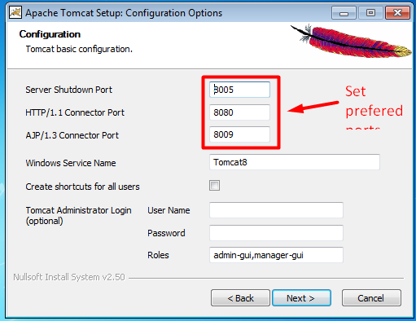
Tomcat Installation guide

Slide 18
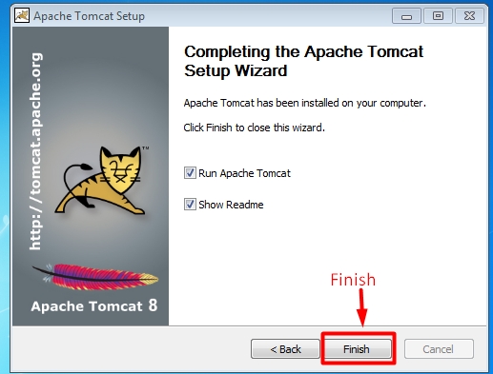
Tomcat Installation guide

Slide 19

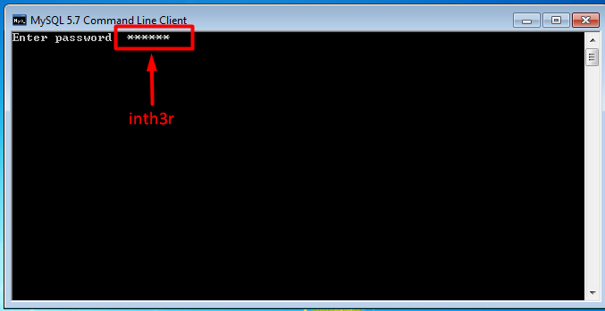
Import Database

Slide 20
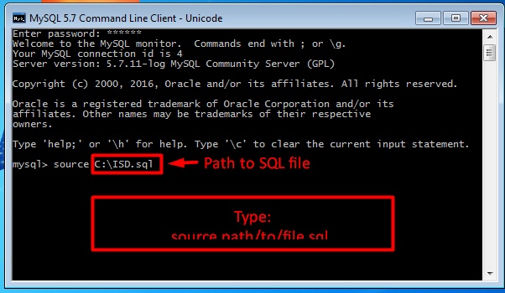
Import Database

Slide 21
Deploy .war files
copy server.war into Tomcat/webapps/ folder
copy client.war into Tomcat/webapps/ folder

Slide 22
Done!
Go to your preferred web browser and type host machines IP followed by assigned Tomcat port and type /client

